Slide 1
Computer Programming Ⅰ (COSE101)
Project 2. 64 PuyoPuyo
2019 Spring Semester
Prof. Sungdeok Cha, Junbeom Hur
TA. Jinhee Lee, Hyundo Yoon, Hodong Kim

Slide 2
Environment
Windows 10
Visual Studio 2017
Programming language: C (C++ will not be allowed.)

Slide 3
Project 2 – 64 PuyoPuyo
Write a program “64 PuyoPuyo”
64 PuyoPuyo is a block-matching puzzle game
Each block consists of a number and a binary arithmetic operator (addition or difference)
Merge two numbers with one operator
When it reaches 64, the block vanishes and user earns points
Goal of each stage is to earn certain points

Slide 4
New Block
The number of a new block has one of the following numbers with certain ratio
2 for 50%
4 for 30%
8 for 20%
The arithmetic operator of a new block has one of the following operators with certain ratio
Addition (+) for 50%
Difference (-) for 50% (e.g., 3-5 = 2, not -2)
From stage 1 to 3, only addition is assigned to the block

Slide 5
New Block
Each block should be created and starts falling from the top of game screen
It consists of two blocks of numbers and operators and is generated only in the horizontal direction
The horizontal coordinate of new blocks should be determined randomly
If the block cannot fall anymore, the next block should be created, and starts falling down again
Ex)
8
+
( O )
8
( X )
+

Slide 6
Block control
While the block is falling, the player can flip the block (change the locations of number and operator) with ‘up’ direction key, and move the block to down, left, or right with each corresponding direction keys from the keyboard
Cannot move after the block reaches to the bottom or other blocks which are already laid down
Cannot move beyond boundary of the game screen
스페이스바 → 하드 드롭. 바로 바닥으로 떨구기

Slide 7
Separation of block
A block can be separated as follows
8
+
8
+
8
+
4
+
4
+
4
+
8
+
8
+
8
+
‘(8, +)’ is created
and falling
‘8’ reaches to ‘4’
and stop falling
‘+’ keep falling
until reaches to ‘2’

Slide 8
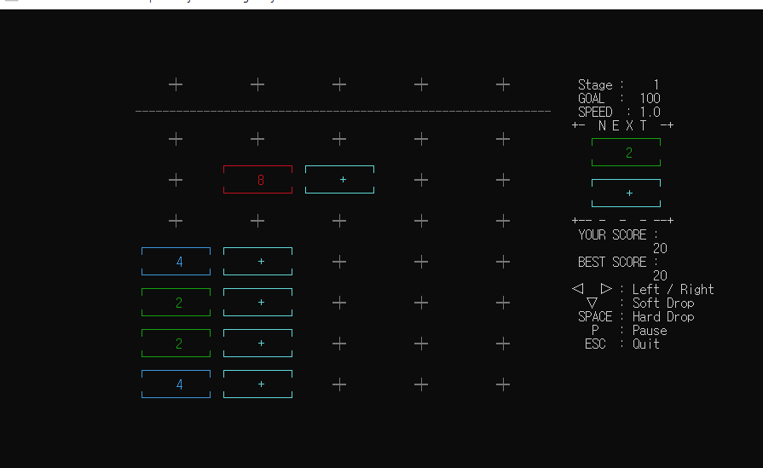
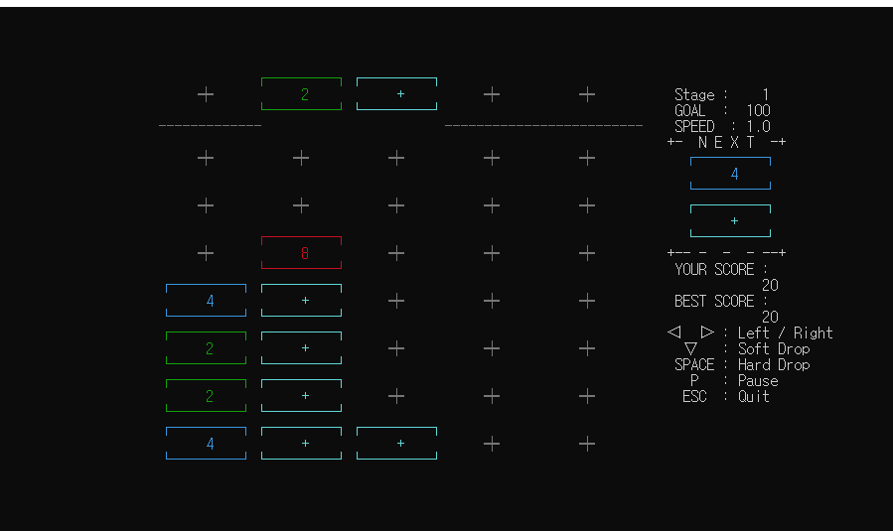
Separation of block
Separation of block example

Slide 9
Merging blocks
When the falling block reached to the bottom or another block which is already laid down, program finds out if there are any of surrounding blocks that can be merged
Blocks can be merged if adjacent blocks are in an order of ‘number’ ‘operator’ ‘number’
Blocks can be merged between vertical and horizontal adjacent blocks
The merging can happen consecutively
If a merged output results in another merging condition, those blocks should be merged consecutively

Slide 10
Merging Rule
수평 방향으로 병합이 이뤄지면 결과값이 가장 왼쪽으로 가도록
수직 방향으로 병합이 이뤄지면 결과값이 가장 아래쪽으로 가도록
덧셈하고 뺄셈이 한줄에 이뤄지는 경우에는 덧셈 먼저
2
+
8
10
2
-
8
+
4
2
-
12
10

Slide 11
Merging Rule
When the merging (calculation) result is zero, then the block becomes * block, which means it is a dead block
2
-
2
*

Slide 12
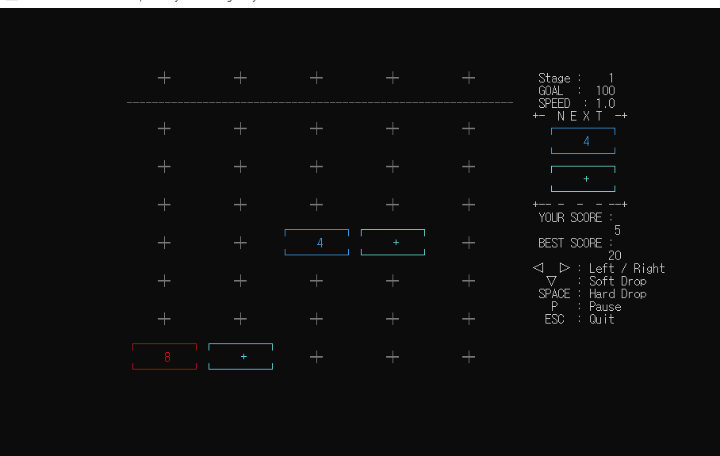
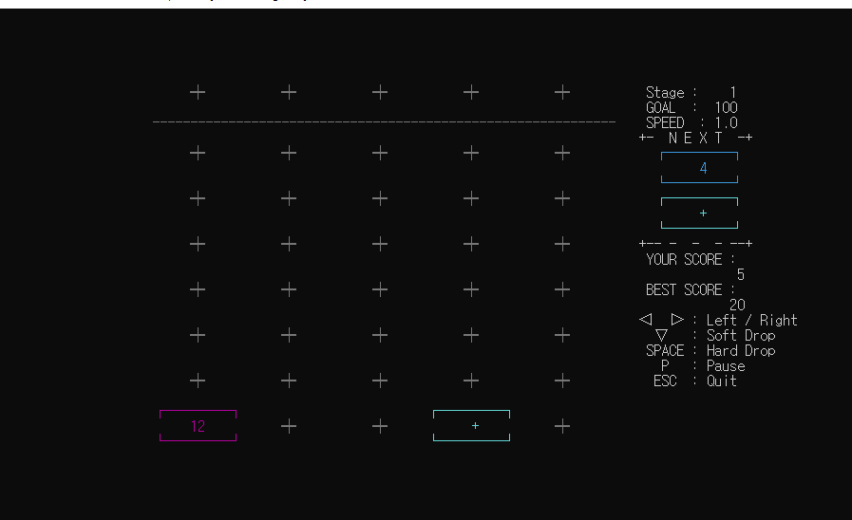
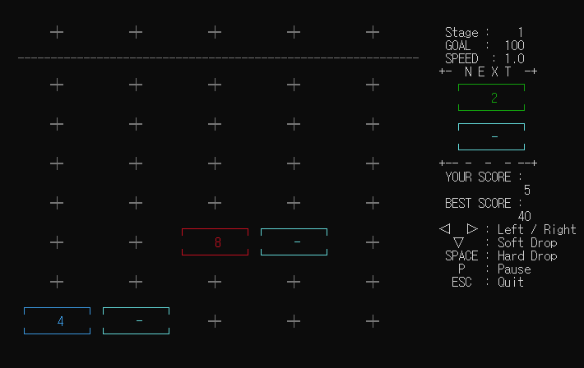
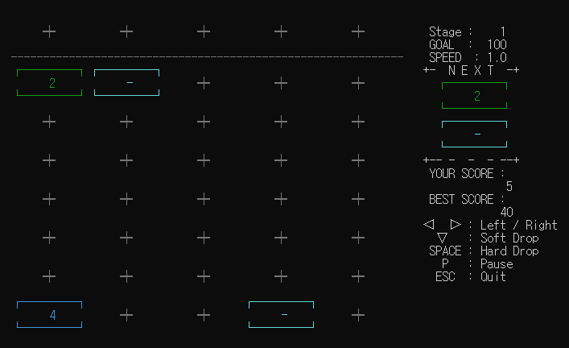
Merging Example
1. Add Operator
2. Difference Operator

Slide 13
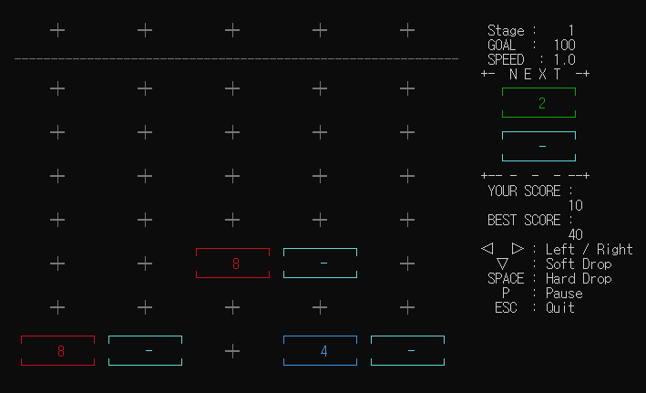
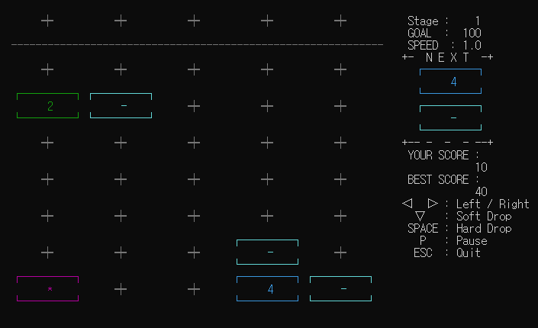
Merging Example
Ex) 8 – 8 = 0

Slide 14
Merging Rule
수평 방향과 수직 방향 병합이 동시에 이뤄져야 할 대는 수평 방향 우선
8
+
8
2
+
+
8
2
+
+
8
+
8
6
+
+
8
+
6
+

Slide 15
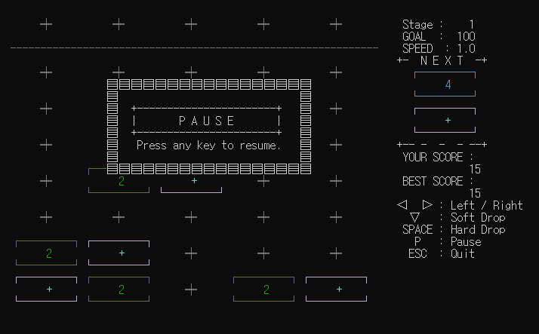
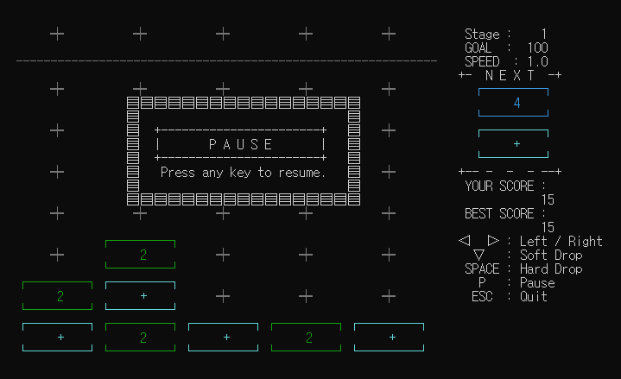
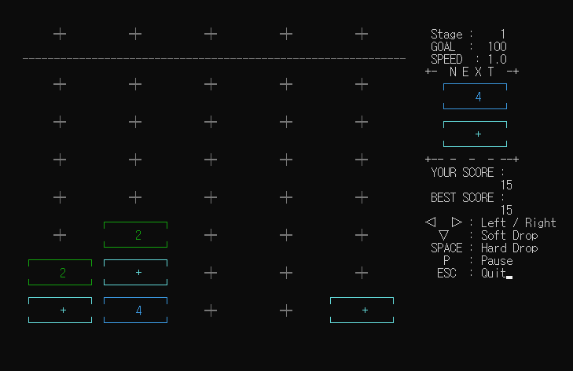
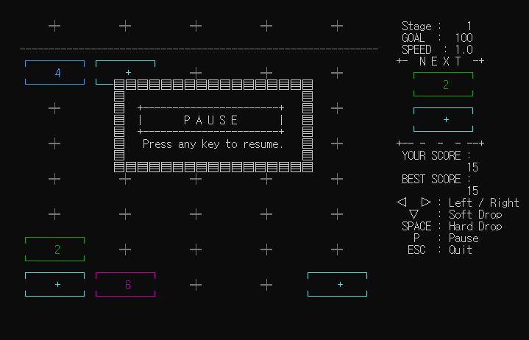
Merging Rule
1.
2.
3.
4.

Slide 16
Stages
The game has 6 stages with different goal, block speed, and operators
Stage | Goal point | Block speed | Operator
1 | 100 | 1 (Initial speed) | + 만 나오도록
2 | 300 | 1.3
3 | 500 | 1.5
4 | 600 | 1.7 | +, -
5 | 750 | 2
6 | 850 | 2.5

Slide 17
Stages
Player wins the stage when having reached the goal point
Player wins the game when cleared all stages
Player loses game when blocks reach up to the top of the game screen
The player must complete the previous stage for moving to the next stage
Each time the player move on to next stages, corresponding values of goal point and block speed need to be set and continues the game

Slide 18
Scoring Rule
When 2 blocks of 64 vanish, then player earns 10 points
2 blocks – 10 points, 3 blocks – 20 points, 4 blocks – 30 points, and so on…
When ‘Hard drop’ the block, 5 points are increased as a bonus
The score will be accumulated after the player clear the stages
The score is reset when the game ends
The highest score is displayed until the program ends

Slide 19
Function key
Player can ‘Pause’ game with pressing ‘p’ key from keyboard and resume by pressing ‘p’ again
Player can go back to ‘Main menu’ by pressing ‘Esc’ key from keyboard while playing game
Player can ‘Exit game’ by pressing ‘Esc’ key from keyboard in the main menu

Slide 20
Note
Use the given sample code to complete your project
You can add or modify the specified area in the sample code as you want
Exceptions need to be well handled including invalid inputs

Slide 21
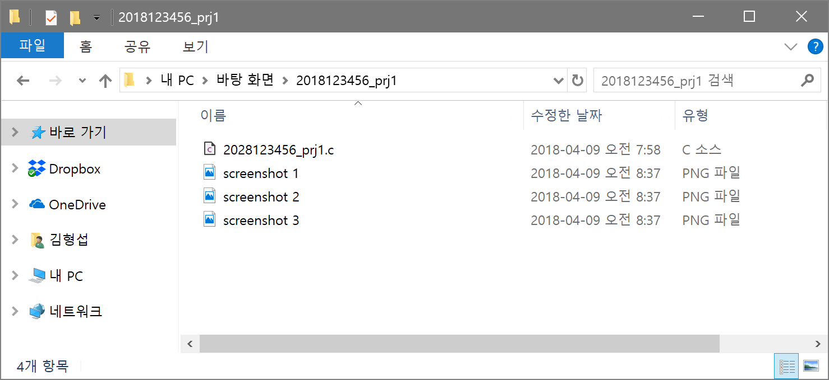
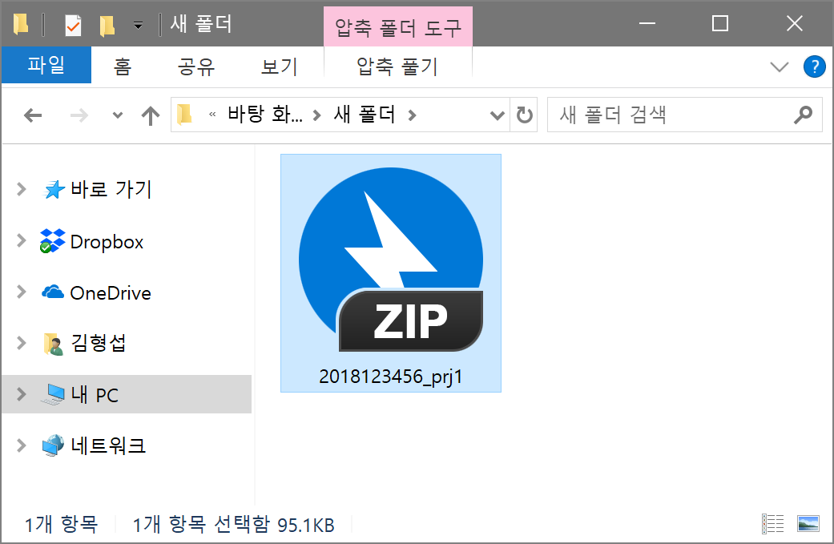
Submission Format
Submit a file “Student ID_prj2.zip”
Source File “Student ID_prj2.c”
Several Screenshots “screenshot #”
Menu screen
Stage screen before start
Stage screen with the score
BlackBoard (kulms.korea.ac.kr)

Slide 22
Submission Due Date
Deadline: 23:59, June 14, 2019
Please try to submit a little bit earlier than deadline
Late submission would not be accepted without exception
Any cheating (e.g., code sharing, copy, writing by deputy, and so on) will be seriously penalized
All people related with cheating (not only those who copied it, but also those who showed it by posting it on the public board such as blog, SNS, …) will get 0 point and F grade

